Slide 1
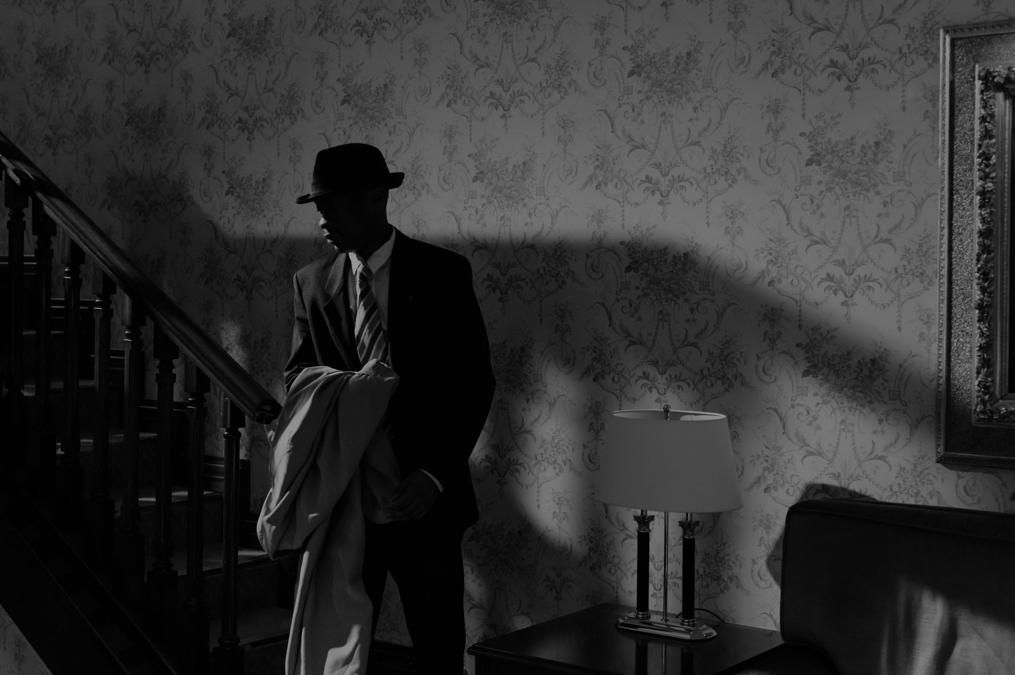
A STORY BY RATHNA KAMAL
STIOCHKOV ’S
CASE
AN INVESTIGATIVE FILE

Slide 2
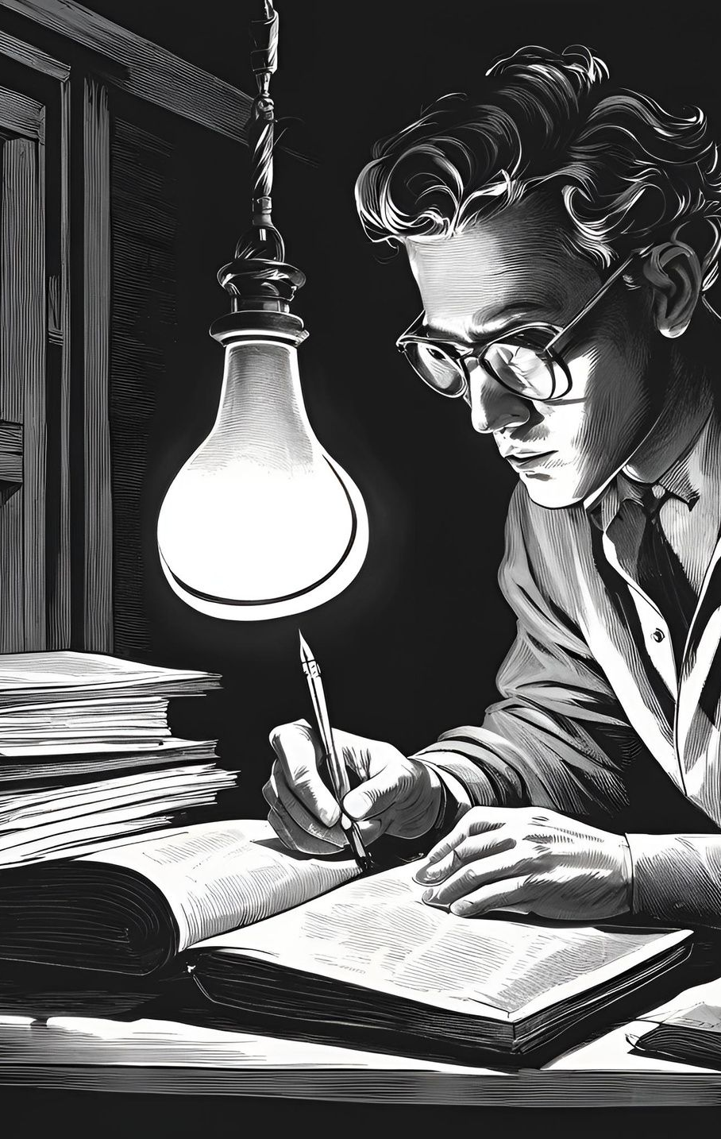
HELLO!
My name is Jonnalagadda Rathna kamal; An aspiring Story writer and have a keen eye for creative regarding quest development and designing it. This my story application regarding to join your company” CD Projekt RED” as an ‘Intern’ in Quest designing and Development.
If you like my Story or my application we can talk it over and can move forward with next step, thank you.
The story presented is made of fiction inspired by true events, if there are any kind of resemblances to the real world in the form of names , places, things; those are purely coincidental and not by means referring to any real life characters; Thank you.
P.S. (Madam Anna Krawczyk If your are reading; I hope that you might enjoy this, Sorry for any inconvenience.)

Slide 3

The Given PPT will be a read-only File due to patent Issues. The slide show will be in it’s best format form so that you the “Reader” can enjoy.
Thank you.
- Rathna kamal

Slide 4
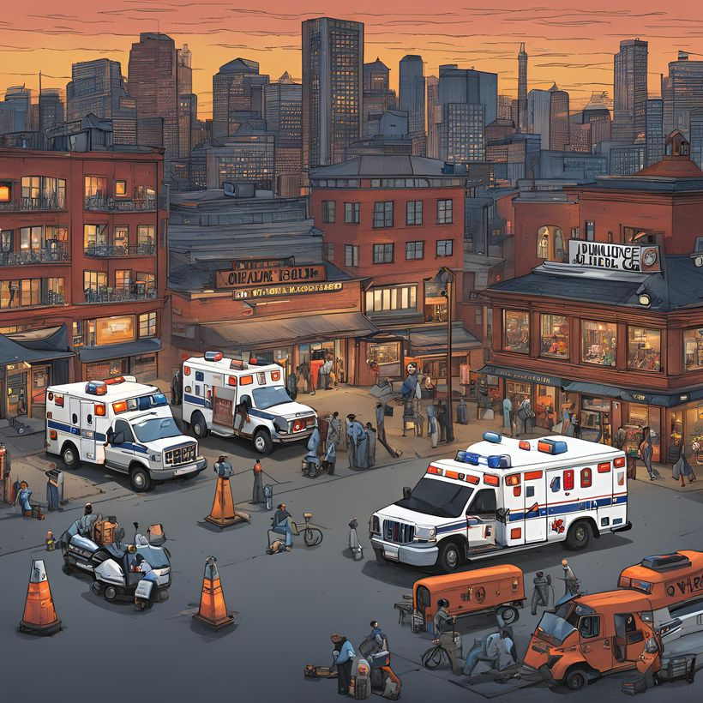
STORY
Time ‘12:40’ A.M. the city’s silent nature is broken by the siren sound of ambulance and the cops cars nearby as the camera slowly shifts to a bar.
The officers are trying to clear the area while the detectives inside are baffled by what they have seen.
“10 People died in which 4 of them are burned, Looking at their scar tissues it seems they were burned alive; I suppose” says the newly appointed detective Rose as she was taking her notes. Her voice was filled with fear and a wanted itch to get out of that Slaughter house.
The Tinn's bar was supposed to be welcomed by everyone and opened all night; but most of the guys you find are mostly crooks, thieves ,criminals the ‘worst kind’ a city has to offer.

Slide 5
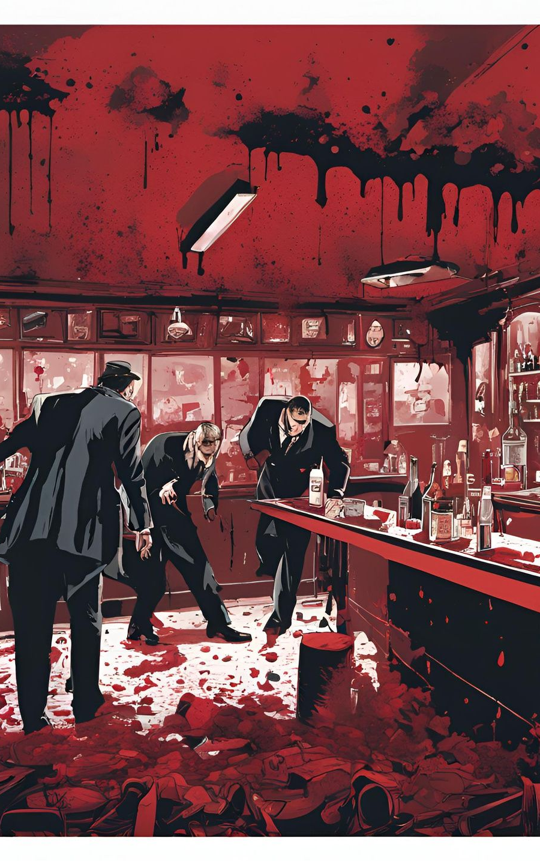
the bar owner Robert Tinn arrived to the scene and started asking questions which is mostly we had since we arrived;
“WHAT THE HELL HAPPEND?, WHO DID THIS ?, WHY THIS BAR OF ALL PALCES?”
the officers are trying to clam him down but the questions were kept on coming but the answers were mere.
“Sir we have found a survivor, She’s Ok”. Lieutenant Shane’s voice hit me like a hot water poured on a winter night. ‘Bring her here , the medic will take a look’
as they were bring her I saw her eyes She was afraid; Scared from what she saw or heard.
must have been pretty gruesome; Something this is city is known for.

Slide 6
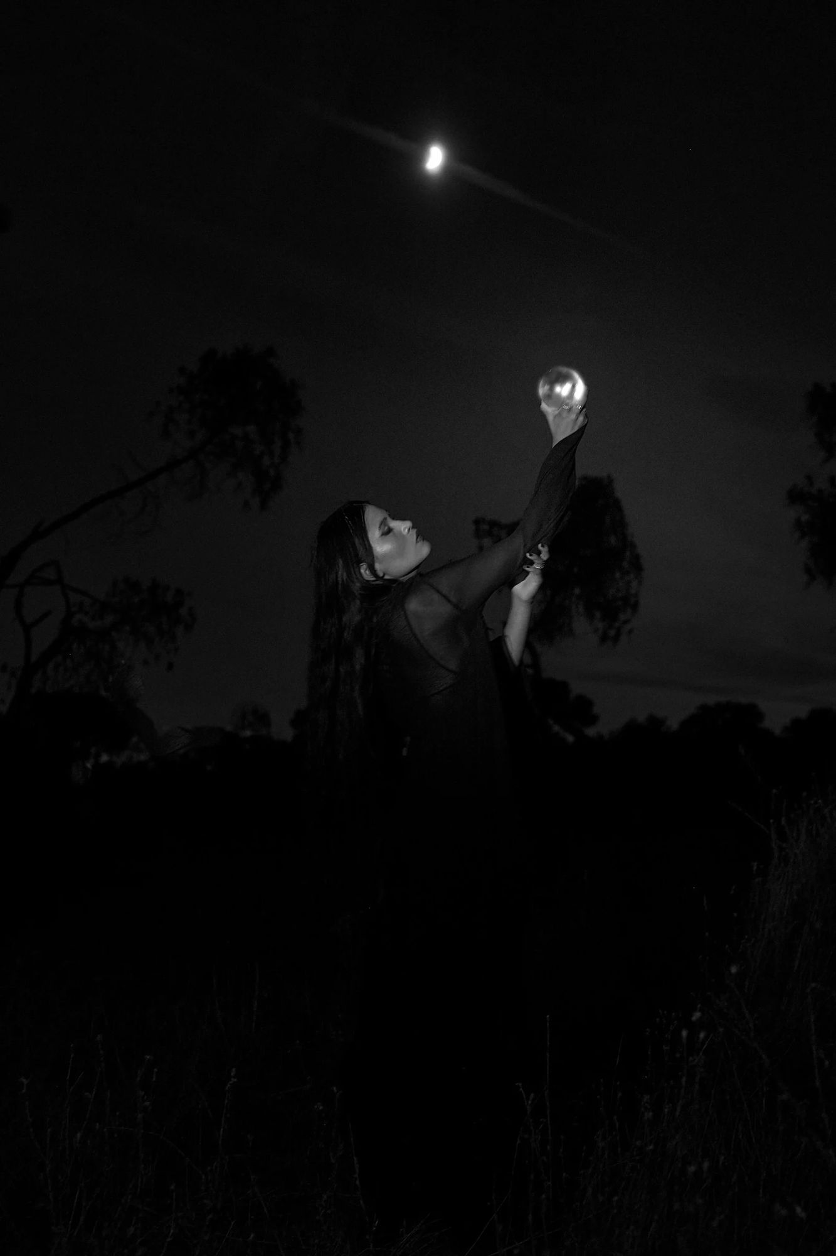
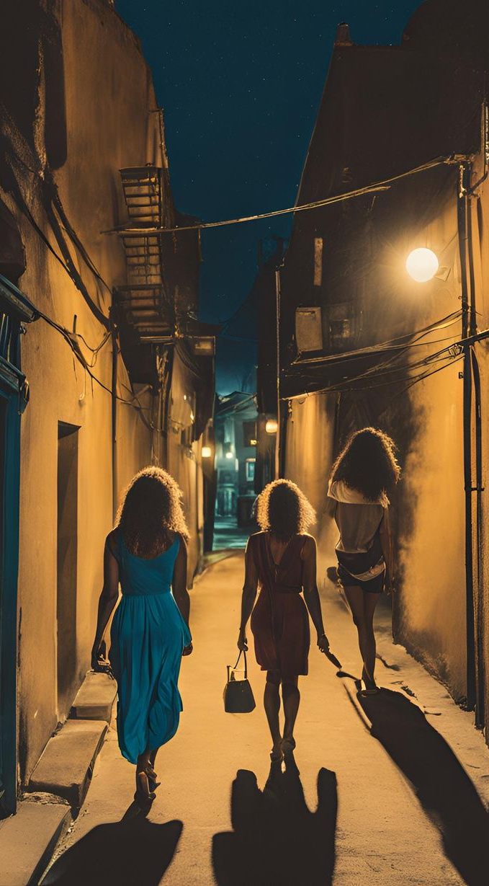
Every day this city is going down and the people like me trying to save it are still trying. I guess we all have our own dreams to cheer.
Me; ‘I always wanted to make sure that my daughter and my wife can have a free stroll around the city without any stupid bastard trying to mug them.’ I know some fucking dream, most of the people here wanted their dreams to be fulfilled not others; That’s politics.
‘These kids who died are the ones who get attracted by small things; things they thought will give them power over the other person, now dead without living their rest of their lives; Some society we live in. ‘
The Medic team lead by Shawn are trying to get the young woman in a calm mood while the rest of us are trying to find something to get started..

Slide 7

Not many gun shot wounds on the victims and the shells found are fired from their guns.
One of the bodies we found by god’s grace not mangled completely , we found a calling card with symbol “A”.
The guns, bodies and the calling card all point towards the “Alcantranz” Mafia in general; has control over most of the city which makes me wonder ‘why aren't there any of ‘their’ people here? they don't want to get noticed by the monsters who did it? maybe’ .
Not a gang war But more of a planned attack as if it is a gang war then there wouldn't be a bar to begin with. The persons who went after these guys must be brave or blind or a fucking retard for all sakes. This ‘Alcantraz’ and its people have more than 100 cases ‘Publicly’ noted and more in the city nights. No body goes after them and people who go mostly end up nakedly hanged with their bodies being grafted at he city central clock or their entire family will be gunned down and their kids bodies being found dead under constructing grounds. There are no morals to them except one “Loyal to death”.

Slide 8

‘Maybe, it was the guy from the action movie the mafia hired to take out these false agendas?; maybe it was in built civil war that these lot are having?’ speculations kept on coming but there were not definitive; but what officer Brown brought that I was not expecting.
“Sir one of the burned bodies is the body-guard to the Don’s son Sir, Here his card he kept in his pocket.”
I was shocked; ‘Don Simon Alcantranz’s son was here when the fighting ensued? and the guy who should be protecting him is now burned to death?’ This revelation gave me and my team a new hope to keep searching to get any information regarding the case.
We were in luck as the survivor has gained some conscience and I was asked to check on her. Me and detective rose went up to her and as Ms. rose was trying to calm her I was to be the “Bad: questioning Cop.
‘Do you remember anything?, Did Don’s son came here when the attack took pace?, Do you know who did it?’ I was fast and had a harsh tone questioning her which made her little bit worried but detective rose made sure that “She is safe and She will be ok no matter what happens”. The woman started talking;
; .

Slide 9
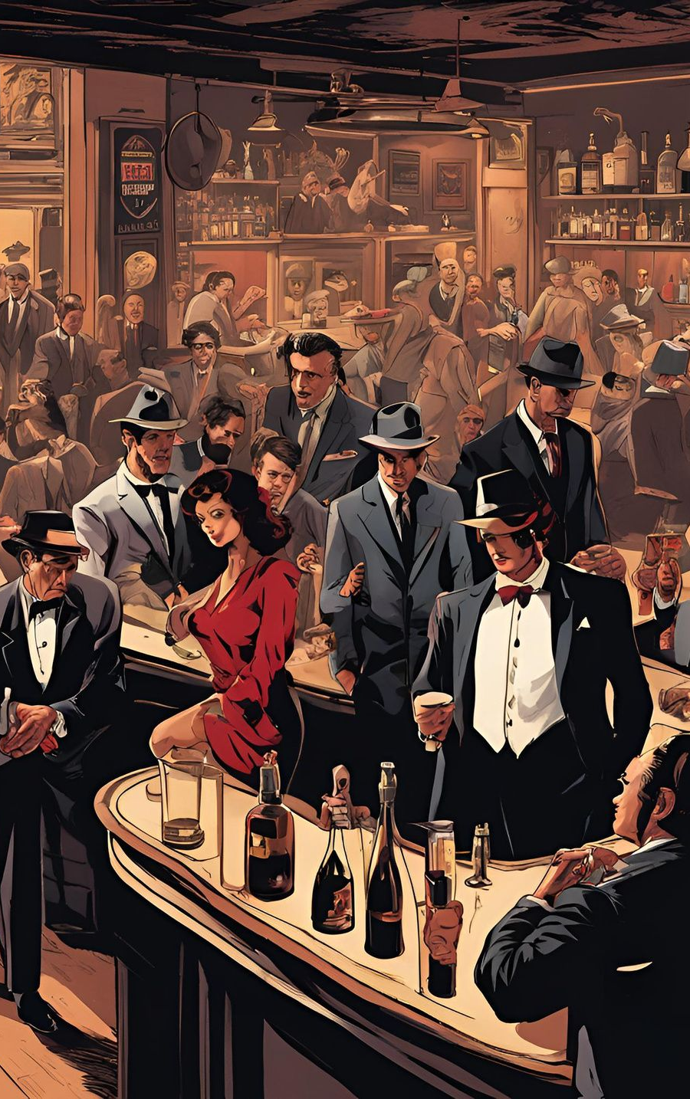
“My name is Tracey I work as a part-time I was supposed to end my session when 5 guys came in and told everyone to leave as the ‘Someone’ special is coming I was told to wait and work for them. They said they will give double than what I was earning.
I had to stay the men took all the bottles and started shouting, enjoying. I heard one of them saying ‘that they had won that stupid case and that wretched piece will be gone next.
Couple minutes later I saw him Don’s Son arriving with his bodyguards. They all were enjoying, Feasting, Drinking Everyone were happy, But then A guy arrived moments later; He was young ordered ‘A Tequila’ one - shot.
The bottles were taken by the gang so I had to go in and bring one for him. As I was getting it, I heard a shot; By the time I arrived there were 2 bodies; One had an entire bottle shoved through his throat.

Slide 10
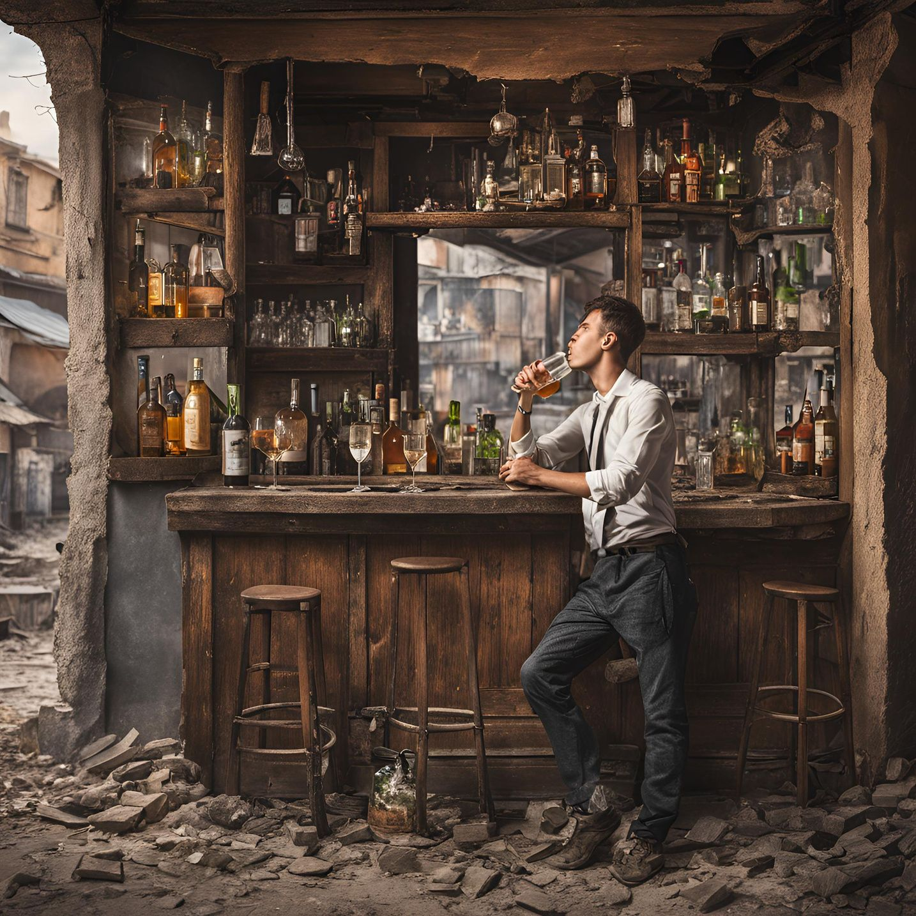
She was trembling as Ms. Rose was giving her water.
She continues; Saying,
:The second guy got his faced Shattered by smashing hardly against the Dart boards. I was Trying to get into My state, This guy takes the nearby Shot-gun and blasted one of the guy body in half. I went inside and hide myself, I heard lot’s screaming, pain, agony I was afraid and I.. I..”
She was and in a mental Shock, poor thing must have been hard for her.
I mean;
‘2 guys got their heads mangled, 2 of them got their heads shoved in different parts of the bar, one guy got his body shattered and 4 Bodies got burned in 5th degree might I add, all of their fingers got cut offed or burned So, If you are asking anything about clues; There is nothing
Which leads to the last guy.’

Slide 11
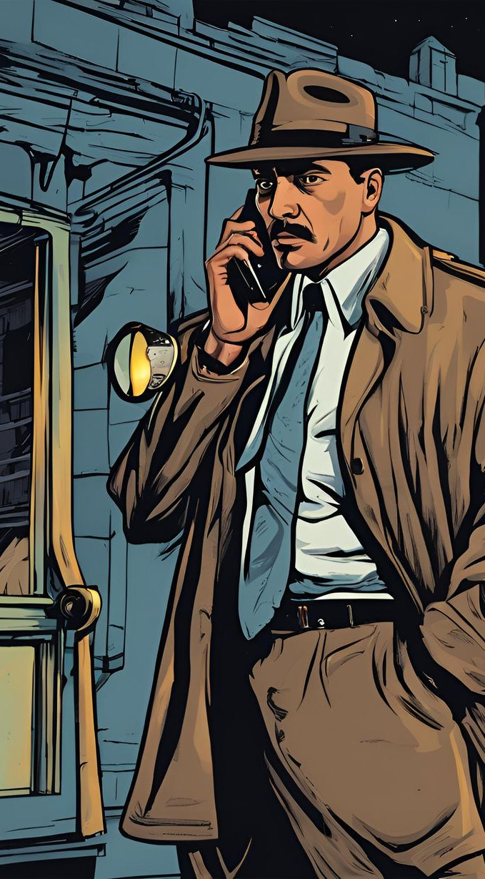
Most of the officers do not want to now about the last guys predicament; All of us were leaving going back to the office checking the clues we got, But then I got a call from the main man himself Don’s son “Stoichkov” Himself. The bastard Survived Lucky him.
When I lifted the call the voice was different.
:HELLOOO Officer. Do not worry, Little Stoikie will be arriving shortly. I hope you are not Surprised by the bar episode. I presume you are not; So UMM..... see you soon, I guess; Adios.”
Call was cut; ‘I know that voice, I know him not a criminal but Some-one that I cared, Some-one who is responsible for all this blood-shed, Some-one Truly Gifted
Detective Alex; The Best in this business.
Case Continues...

Slide 12
I hope the story meet your requirements, If or If not Thank you for taking time to read My short story; I have much more if you needed. Best Regards.
- Rathna kamal

Slide 13
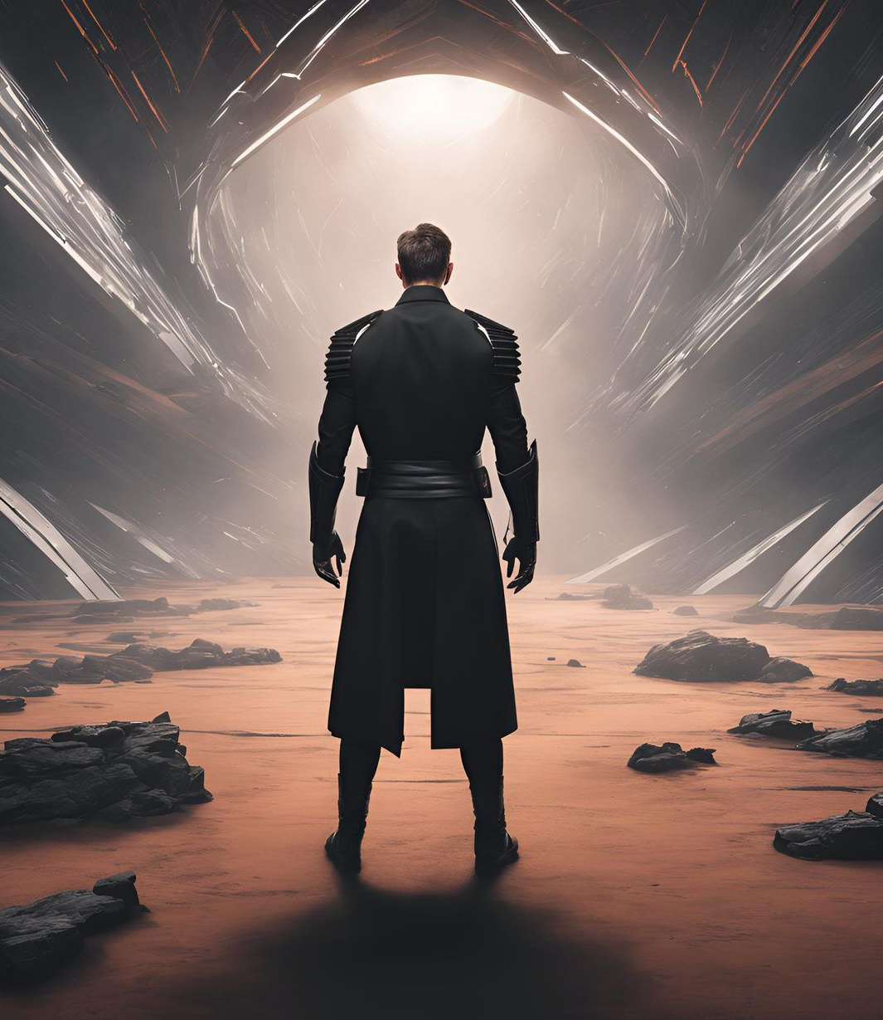
Email
Rathnakamaljonnalagadda2004@gmail.com
CONTACT
Mobile
9441609891, Andhra pradesh, India.

Slide 14
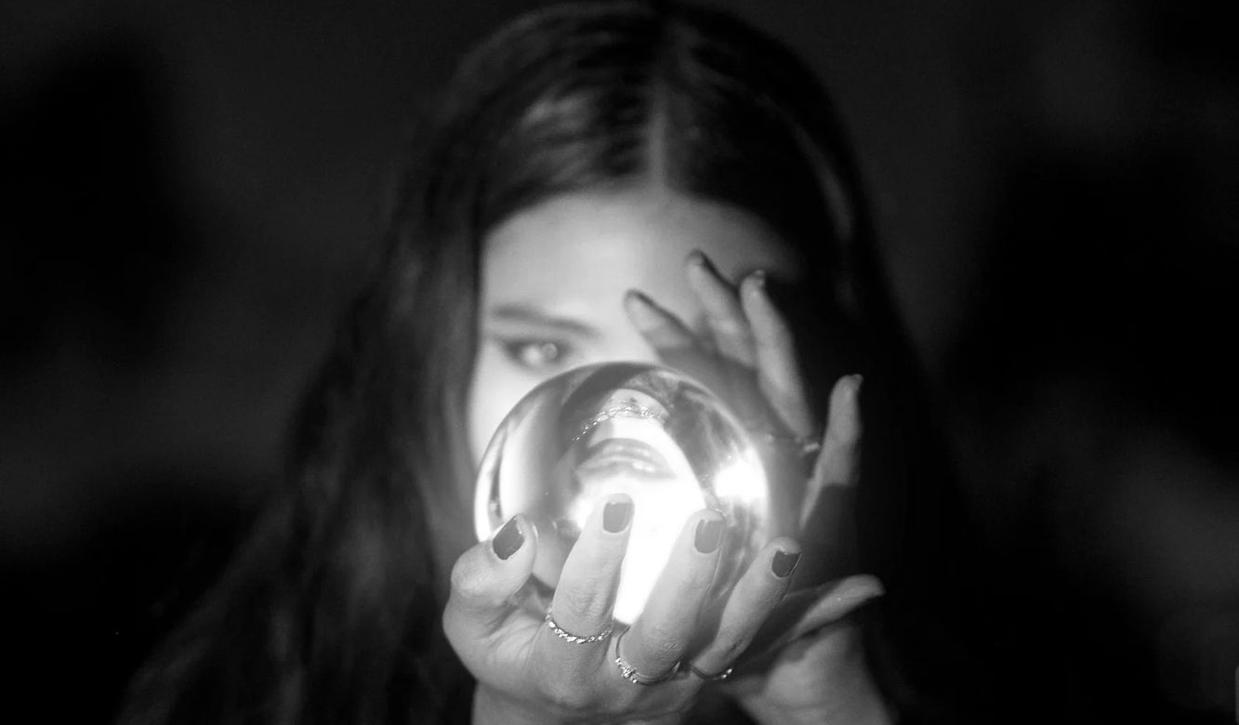
THANK YOU!
Have a nice day and a nice life.

